Slide 1

DEPARTMENT OF ARTIFICIAL INTELLIGENCE AND DATA SCIENCE
Artificial Neural Networks and Deep Learning: 21ADG64
LA1 - SEMINAR
“Binary Classification and Gradient Descent”
Presented By
MD. ALTAMASH
[1NT21AD033]
Name of the Course Instructor Dr Meenakshi

Slide 2

CONTENTS
Introduction and Motivation
Methodology and Approach
Results and Analysis
Conclusion and Future Recommendations
Demo video of code
GitHub link of PPT and Code
References

Slide 3

INTRODUCTION & MOTIVATION
The perceptron is a basic neural network unit that takes multiple input signals, each multiplied by a weight, sums them up, and applies an activation function to produce an output.
For binary classification, the perceptron assigns weights to input features and uses an activation function (e.g., step function) to classify data points into one of two categories based on a decision boundary.
During training, the perceptron adjusts its weights and bias to minimize classification error, typically using algorithms like the perceptron learning rule or gradient descent.
The model's performance is evaluated using metrics such as accuracy, precision, recall, and F1-score on a separate validation or test dataset to assess its effectiveness in classifying unseen data.

Slide 4

Gradient Descent is a fundamental optimization algorithm used in machine learning and computational mathematics. It's a powerful method for minimizing a function by iteratively moving in the direction of the steepest descent of the function's gradient.
In the realm of machine learning, Gradient Descent plays a crucial role in training models, where the objective is to find the optimal parameters that minimize the difference between predicted and actual outcomes.
By iteratively adjusting model parameters based on the gradient of a loss function, Gradient Descent enables the optimization of complex models with high-dimensional parameter spaces.
In Gradient Descent, we move towards the minimum of a function by taking steps proportional to the negative of the gradient at each point.

Slide 5


METHODOLOGY & APPROACH
Data Preparation
Preprocess and split the dataset into training and testing sets.
Initialization
Initialize weights and bias, usually randomly or close to zero.
Forward Propagation
Compute the weighted sum of inputs and apply an activation function to obtain predictions
Loss Calculation
Calculate the loss between predicted and true labels using a suitable loss function.
Gradient Descent
Update weights and bias using gradient descent to minimize the loss.
Evaluation and Tuning
Evaluate model performance on a separate test set and fine-tune hyperparameters as needed.

Slide 6

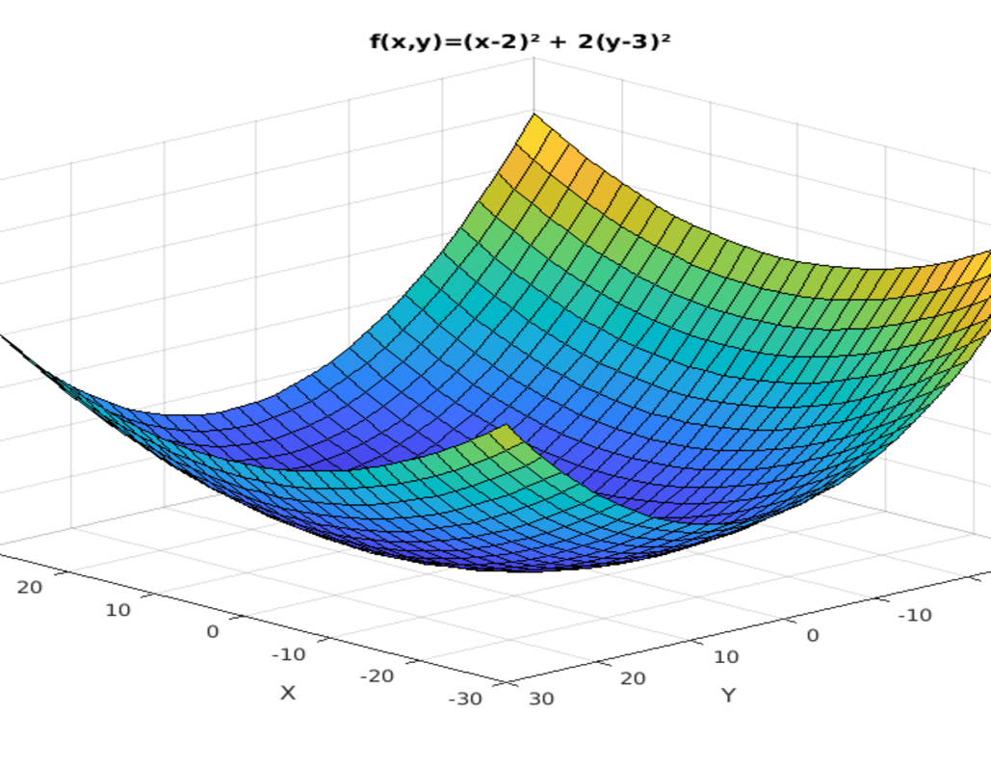
Initialization
Start by initializing the model parameters randomly or with predefined values.
Compute Gradient
Calculate the gradient of the objective function with respect to the model parameters.
Update Parameters
Adjust the parameters in the opposite direction of the gradient
Convergence
Check for convergence by monitoring the change in parameters or the objective function. Repeat steps 2-3 until convergence criteria are met.

Slide 7

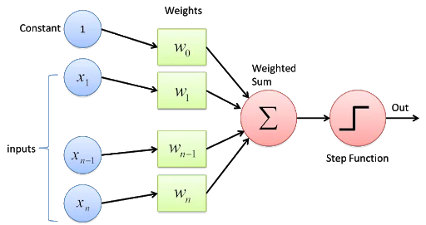
RESULT & ANALYSIS
Advantages
Simple to understand and implement.
Efficient for linearly separable data.
Produces interpretable decision boundaries.
Applications and Considerations
Suitable for basic binary classification tasks.
Requires proper data preprocessing and hyperparameter tuning.
Evaluation using appropriate metrics is crucial for assessing performance and identifying improvements.

Slide 8
Efficiency Gradient Descent efficiently optimizes functions in high-dimensional spaces by iteratively moving in the direction of steepest descent.
Sensitivity to Learning Rate The choice of learning rate affects convergence speed and stability. Fine-tuning is crucial for optimal performance.
Convergence Guaranteed convergence to local minima for convex functions; may converge to saddle points or local minima for non-convex functions.
Variants and Enhancements Various variants, like Stochastic Gradient Descent and Momentum-based methods, offer improved convergence speed and robustness.
Scalability Highly scalable for large-scale optimization tasks, making it suitable for training complex models in machine learning and deep learning.

Slide 9

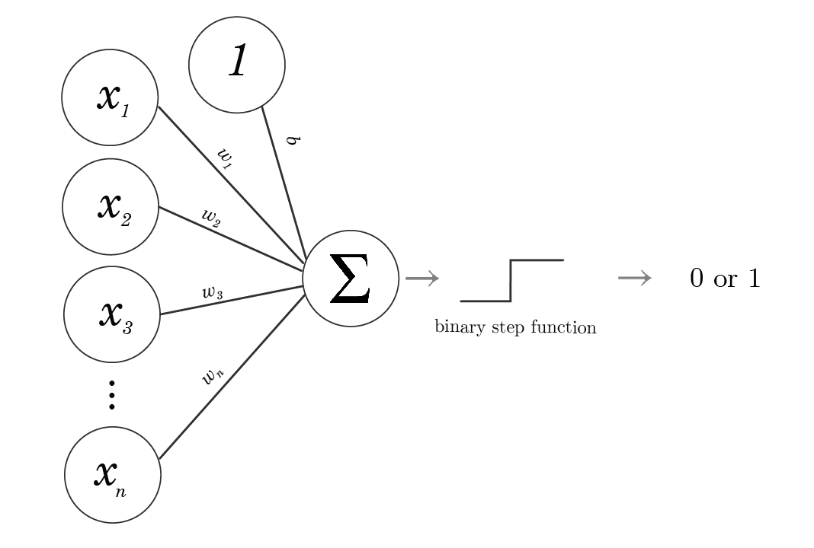
CONCLUSION & FUTURE RECOMMENDATIONS
In conclusion, binary classification with a perceptron offers simplicity and interpretability, making it suitable for basic tasks with linearly separable data.
However, its limitations include sensitivity to noise, potential convergence issues, and the inability to handle complex patterns.
While effective for simple tasks, further improvements such as using multi-layer perceptron or advanced optimization techniques may be necessary for tackling more challenging classification problems

Slide 10

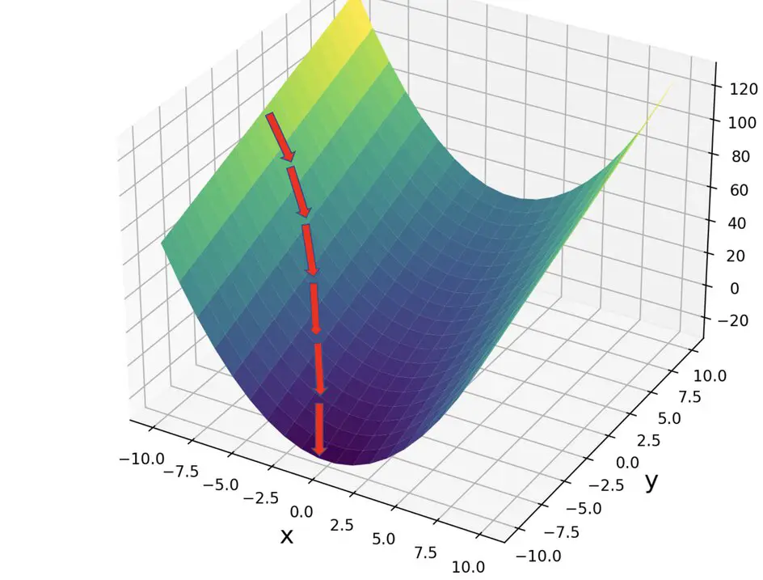
Gradient Descent is a versatile and powerful optimization algorithm that serves as a cornerstone in machine learning and computational mathematics.
Its efficiency in optimizing functions in high-dimensional spaces, scalability for large-scale tasks, and ability to handle complex models make it indispensable in various fields.
advancements in variant algorithms and enhancements offer solutions to improve convergence speed and robustness.
In conclusion, Gradient Descent continues to be a fundamental tool in optimization, driving advancements in machine learning, deep learning, and other computational domains.

Slide 11
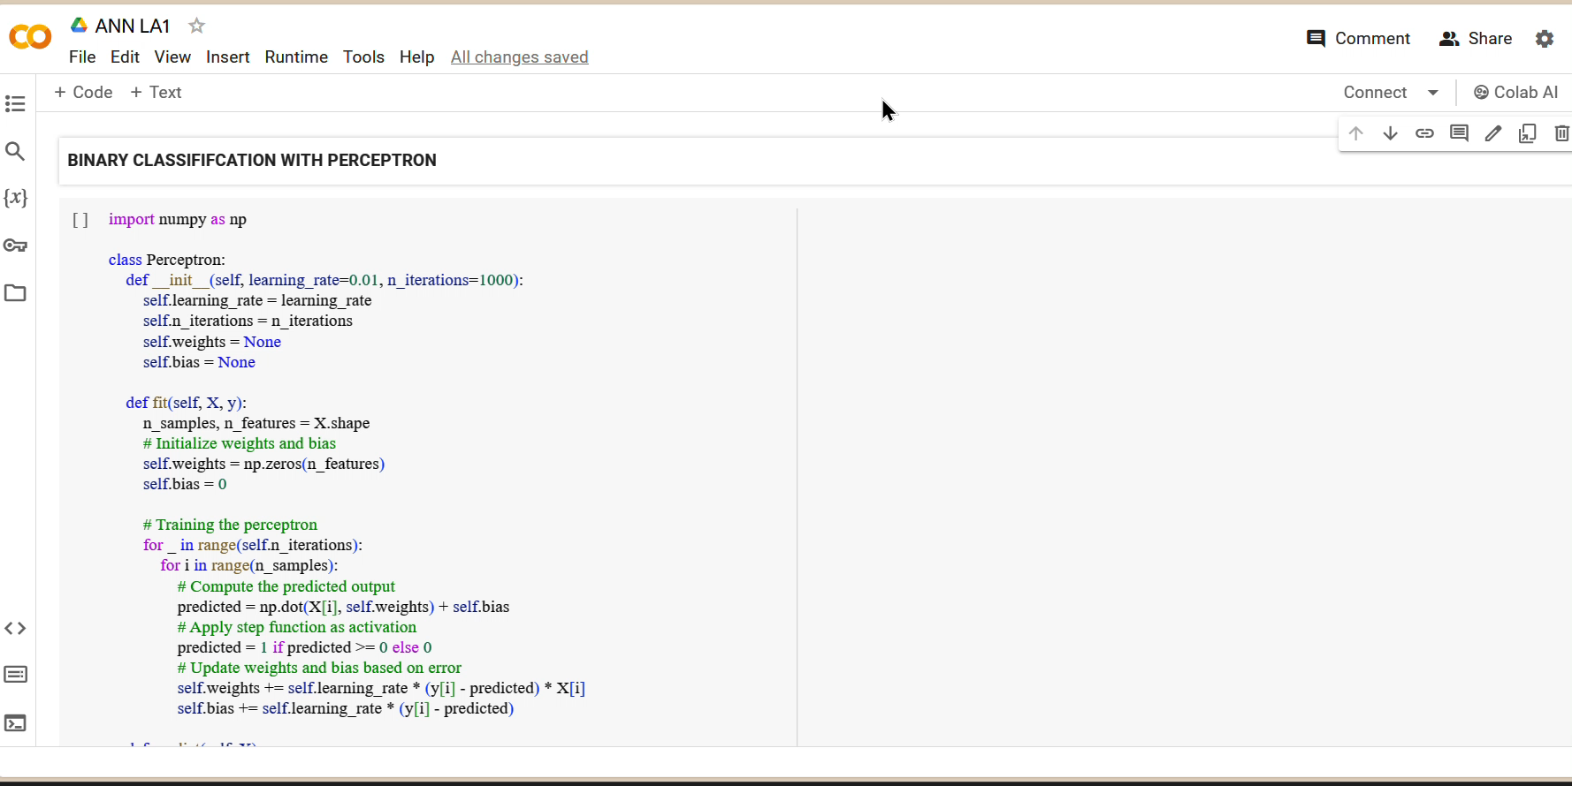
DEMO VIDEO OF CODE

Slide 12
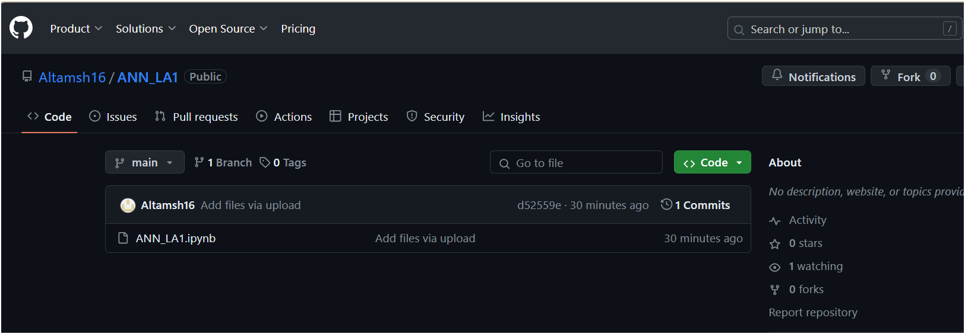
GITHUB LINK
https://github.com/Altamsh16/ANN_LA1.git

Slide 13

REFERENCES
Rosenblatt, F. (1958). The perceptron: A probabilistic model for information storage and organization in the brain. Psychological Review, 65(6), 386-408.
Bishop, C. M. (2006). Pattern recognition and machine learning. Springer.
Haykin, S. (1994). Neural networks: a comprehensive foundation. Prentice Hall.
Bottou, Léon (2012). "Stochastic Gradient Descent Tricks." In Neural Networks: Tricks of the Trade, pp. 421-436. Springer, Berlin, Heidelberg.
Ruder, Sebastian (2016). "An overview of gradient descent optimization algorithms." arXiv preprint arXiv:1609.04747.
Goodfellow, Ian, Yoshua Bengio, and Aaron Courville (2016). "Deep Learning." MIT Press.

